Slide 1
VLSI system design generic apb register file – 1st presentation
Βλαχοσ ξανθοσ 1072
Γρηγοροπουλου αγγελικη 699
Κωνσταντελιας ΙΩΑΝΝησ 1253

Slide 2
Apb bus is
part of Advanced Microcontroller Bus Architecture (AMBA) hierarchy of buses;
optimized for minimal consumption and reduced interface complexity;
used to any peripheral device which are low bandwidth and do not require the high performance of piped bus interface.

Slide 3
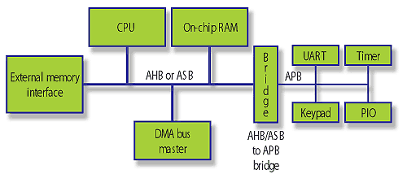
Typical amba system
MASTER
SLAVES
SLAVES

Slide 4
functionality
The AMBA slave interface acts as a bridge between the APB bus and the peripheral device to which the bus is connected. It receives the APB bus signals and converts them to a form in which is understood by the connected peripheral device.
Most common applications of the APB interface is to read and write registers of the connected device. The peripheral devices connected to the APB bus could be UART, Timer, keypad, etc.

Slide 5
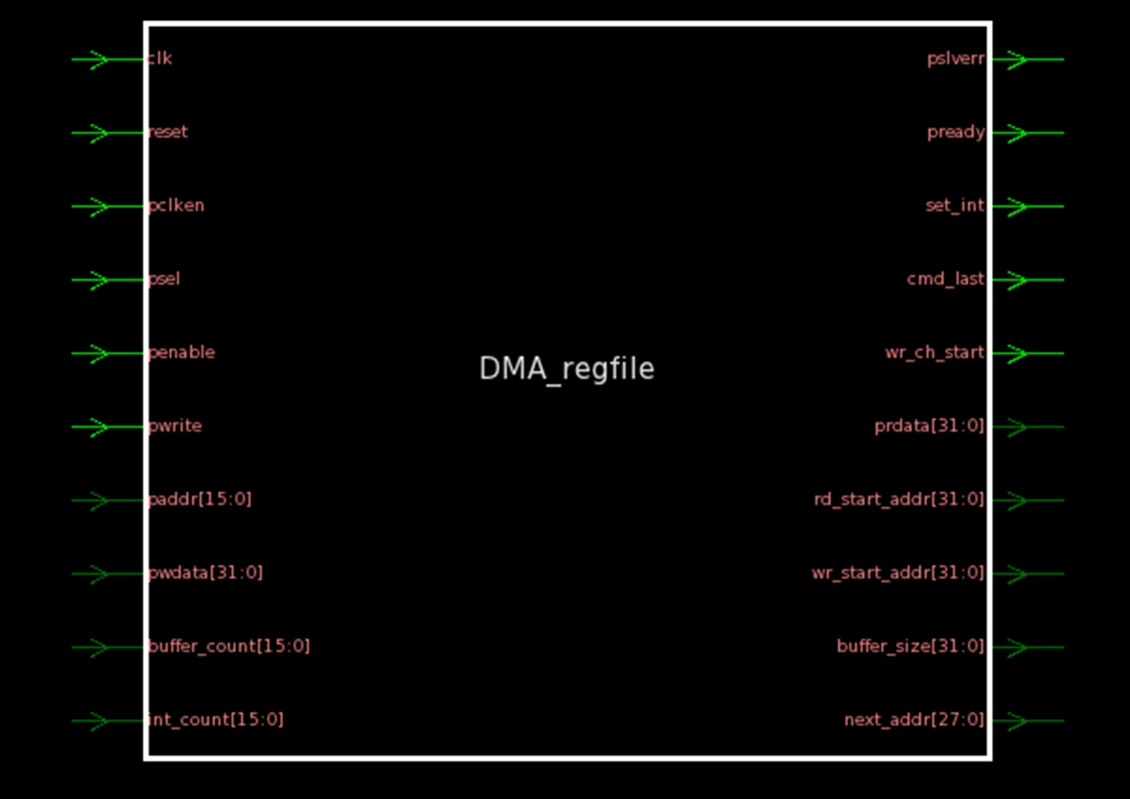
DMA register file interface

Slide 6
Input signals
PCLK : Input APB processor clock . This is used as the reference clock for the peripheral device connected to the APB bus
PRESETn : Active low reset for the system. Input from APB end
PSELx : Input from APB. Acts as enable for selecting that particular device
PENABLE : Input Enable data line.
PWRITE : 1'b0 > Read transfer and 1'b1 > Write transfer
PWDATA : Input data bus from APB bus
PADDR : Input address lines from the APB bus

Slide 7
OUTput signals
PSLVERR : An error signal to indicate the failure of a transfer.
PREADY : The slave uses the signal to extend the APB transfer.
PRDATA : Output data bus to the APB bus.
RD_START_ADDR : Enable signal for reading data from the ram connected to APB IF
WR_START_ADDR : Enable signal for writing data into the ram connected to APB IF
NEXT_ADDR : Next address of the ram to which data has to be written or read from.

Slide 8
IDLE
PSELx = 0
PENABLE = 0
SETUP
PSELx = 1
PENABLE = 0
TRANSFER
NO TRANSFER
PREADY=1 & no transfer
PREADY=1 & transfer
ACCESS
PSELx = 1
PENABLE = 1
PREADY = 0

Slide 9
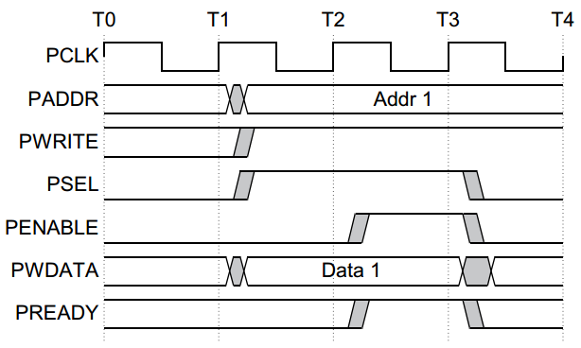
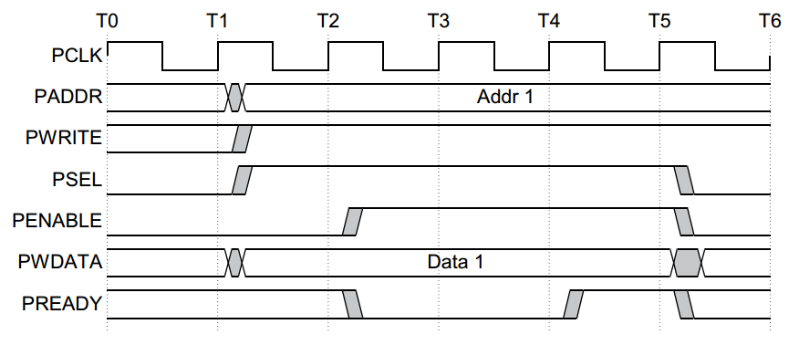
Write transfer without/with wait states
IDLE
SETUP
ACCESS

